Slide 1
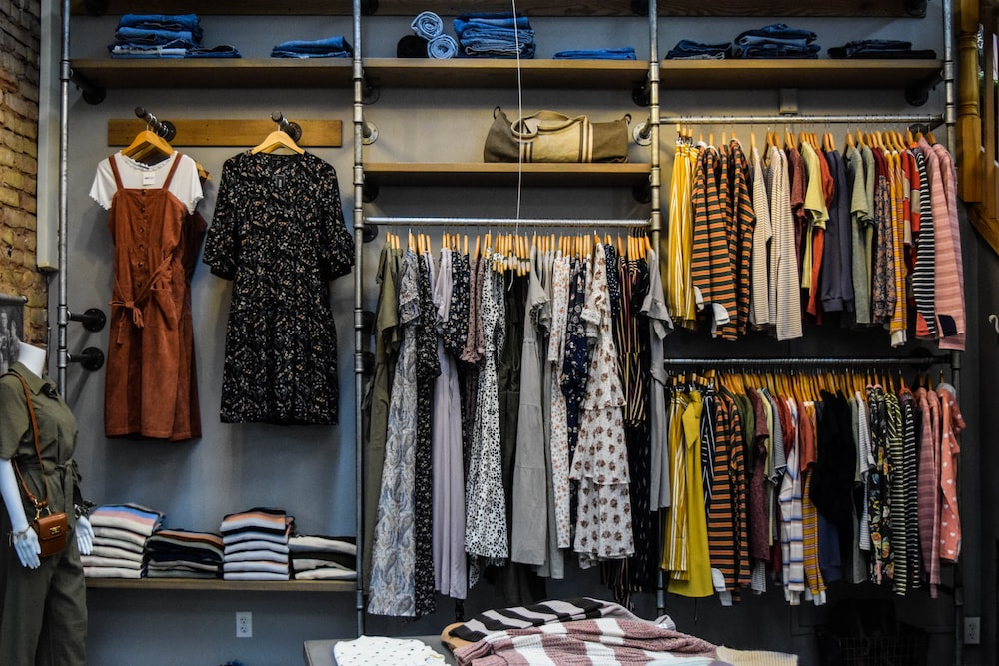
E-Commerce Clothing Website
"Your Fashion, Your Way: Explore the Latest Trends and Styles"

Slide 2
Introduction :-
The E-Commerce Clothing Website is an innovative online platform designed to offer a seamless shopping experience for fashion enthusiasts. This project aims to provide a feature-rich, user-friendly, and secure platform for users to explore, browse, purchase and wish list a wide range of clothing products with the both different category of men and women.
Main purpose :-
The main purpose of the project is to provide users with a convenient and efficient online platform for purchasing clothing and fashion items. This website aims to simplify the process of finding and buying clothing, allowing users to browse through a wide range of products, make secure login and signup, and have option to add the product to the cart, to the wish list and remove it from their whenever required . The project's core goal is to enhance the overall shopping experience for both buyers and sellers in the realm of clothing and fashion.

Slide 3
Technologies used :-
The project utilizes a combination of technologies for both its frontend and backend development. The project is basically build using MERN. Let's introduce the technologies used in each:
Frontend technology:
Backend technology:-
React: The frontend of the E-Commerce Clothing Website is built using React, a popular JavaScript library for building user interfaces.
Redux: Redux is used for state management in the frontend.
Axios: Axios is used for making HTTP requests from the frontend to the backend. It facilitates the retrieval and posting of data between the client and server.
HTML/CSS: HTML is used for structuring web pages, while CSS is employed for styling and layout.
Node.js: The backend of the project is powered by Node.js, which allows server-side scripting using JavaScript.
Express: Express is a web application framework for Node.js. It simplifies the creation of APIs and routes, making.
Mongo DB: Mongo DB serves as the project's database. It's a No SQL database that stores data in a flexible, JSON-like format. Mongo DB is well-suited for handling large volumes of unstructured data.
Bcrypt: Bcrypt is used for hashing user passwords, ensuring the security of user data.

Slide 4
Detailed Working:--
Certainly! Here's a detailed overview of how the E-Commerce Clothing Website works, covering the main functionalities from home to logout:
Home Page:-
When a user visits the website, they land on the Home Page.
The Home Page typically displays products, and its categories if user do successful signup & login.
2. Sign-Up:-
Users who are new to the website can sign up for an account.
They provide information such as username, email, password, contact details, and user type during registration.
The backend validates and stores the user information in the database.
Upon successful registration, users receive a confirmation message.
3. Login:-
Registered users can log in using their email and password.

Slide 5
The backend authenticates the user's credentials.
Upon successful login, users are redirected to their home page.
4. Home (Logged In):-
Once logged in, users see a personalized Home Page.
On home page users have a button shop now when they click on it will be redirected to product page.
Users can continue browsing products and add items to their cart or wish list.
5. Products Page:-
Users can navigate to the Products Page to explore the full range of products available.
They can filter and sort products name.
It displays three main button if user click on all it will display all the products available, if on male if will display all the products available for men and same for women.
6. About Us:-
The "About Us" page provides information about the company and its image gallery.
Users can learn more about the brand and its commitment to quality.

Slide 6
7. Contact Us:-
The "Contact Us" page offers ways for users to get in touch with customer support.
Users can fill out a contact form, send emails, or find contact information.
8. Cart:-
Users can add products to their shopping cart while browsing.
The Cart Page displays the selected items, their quantities, and total prices.
Users can update quantities, remove items, or proceed to checkout from the cart.
9. Wish list:- The wish list page allows users to save products they are interested in for future reference.
Users can add or remove items from their wish list.
It helps users keep track of products they might want to purchase later.
10. Logout:- Users can log out of their accounts when they're done shopping or browsing.
Logging out ensures the security of their account information.
Overall, the E-Commerce Clothing Website aims to provide a convenient and enjoyable shopping experience for users interested in clothing and fashion items.

Slide 7
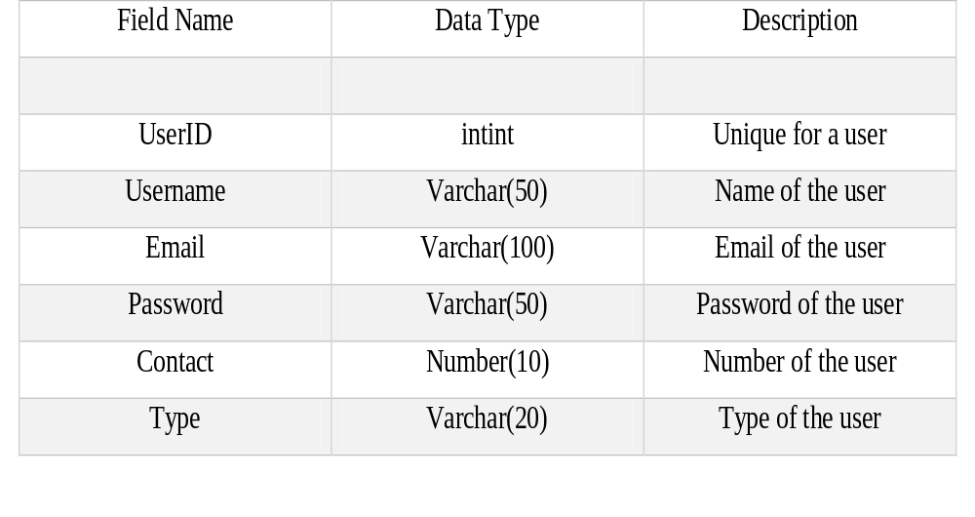
Data dictionary:-
Table:- Users Categories
Field Name | Data Type | Description
CategoryId | int | Unique identifier for a category
Name | Varchar(50) | Name of the category

Slide 8
Table:- Product CartItem
Field Name | Data Type | Description
Image | Binary | Image of the product added to cart
Name | Varchar(100) | Name of the product added to cart
Price | int | Price of the product added to cart
Quantity | int | Quantity of the product added to cart
Action | button | Product you want to remove from cart
Total Products | int | Total numbers of the product in the cart
Total Price | number | Total number of the price of the product added to cart
Field Name | Data Type | Description
ProductId | int | Unique for a user
Name | Varchar(100) | Name of the product
Image | Binary | Image of the product
Description | text | Detailed description of the product
Category | Varchar(20) | Category of the product
Price | Number | Price of the product
Quantity | Number | Quantity of the product

Slide 9
Table:- Wishlist Contact
Field Name | Data Type | Description
Image | Binary | Image of the product added to cart
Name | Varchar(100) | Name of the product added to cart
Price | int | Price of the product added to cart
Action | button | Product you want to remove from cart
Field Name | Data Type | Description
Name | Varchar(200) | Name of the user
Email | Varchar(200) | Email of the user
Your Review or Message | Varchar(200) | Your message or review you want to give to the admin

Slide 10
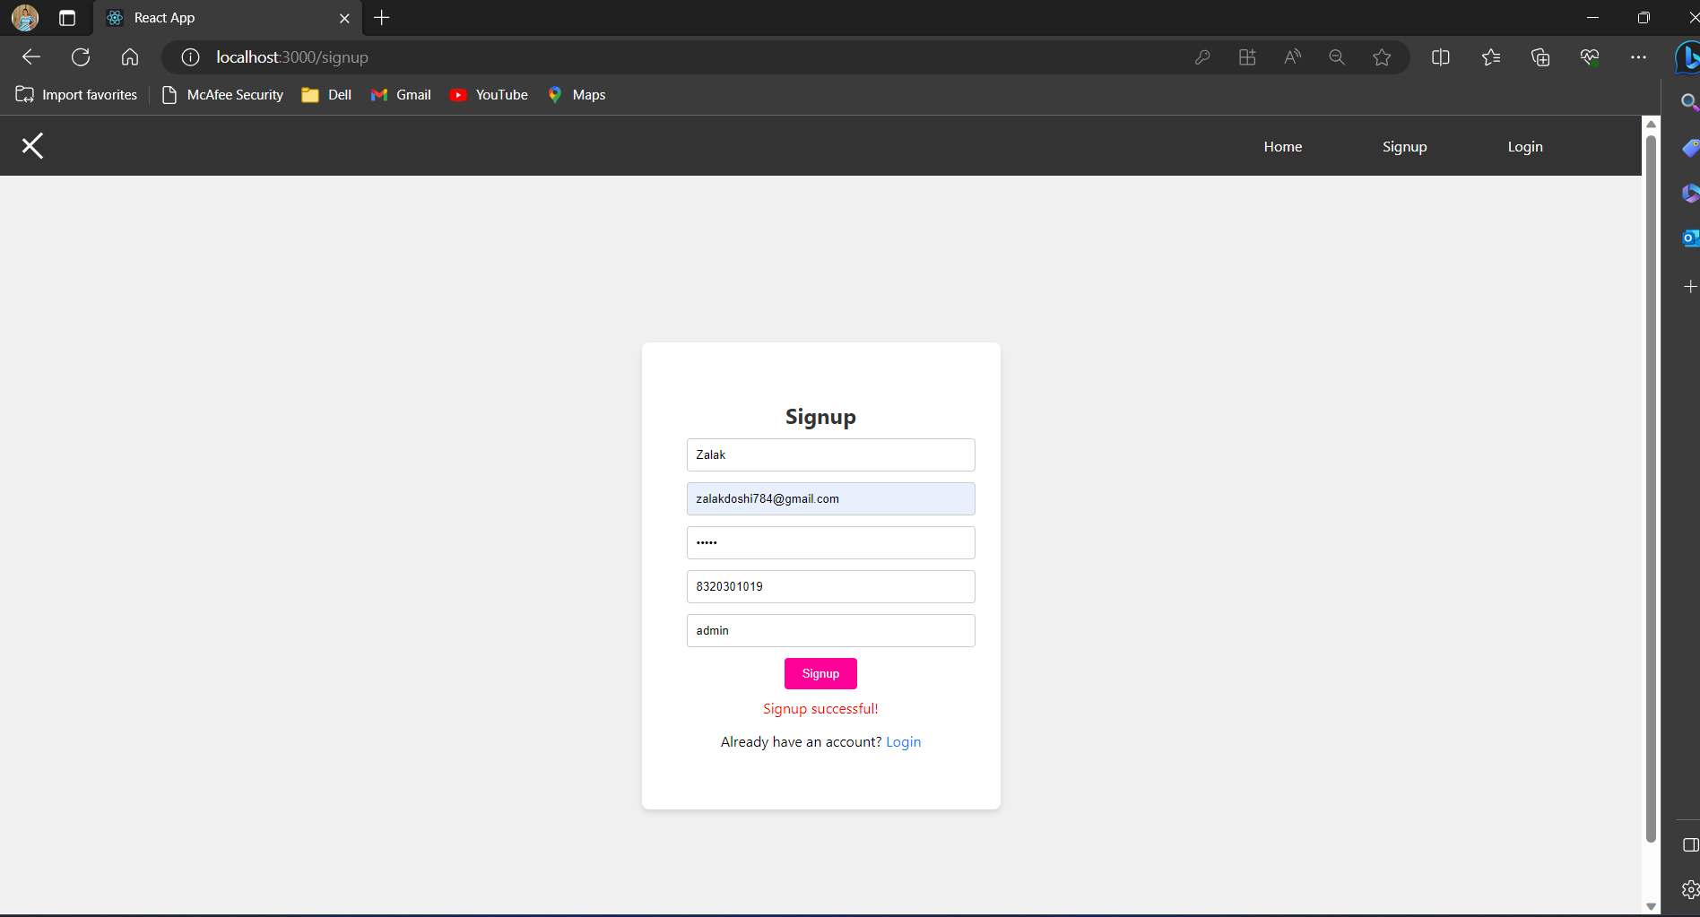
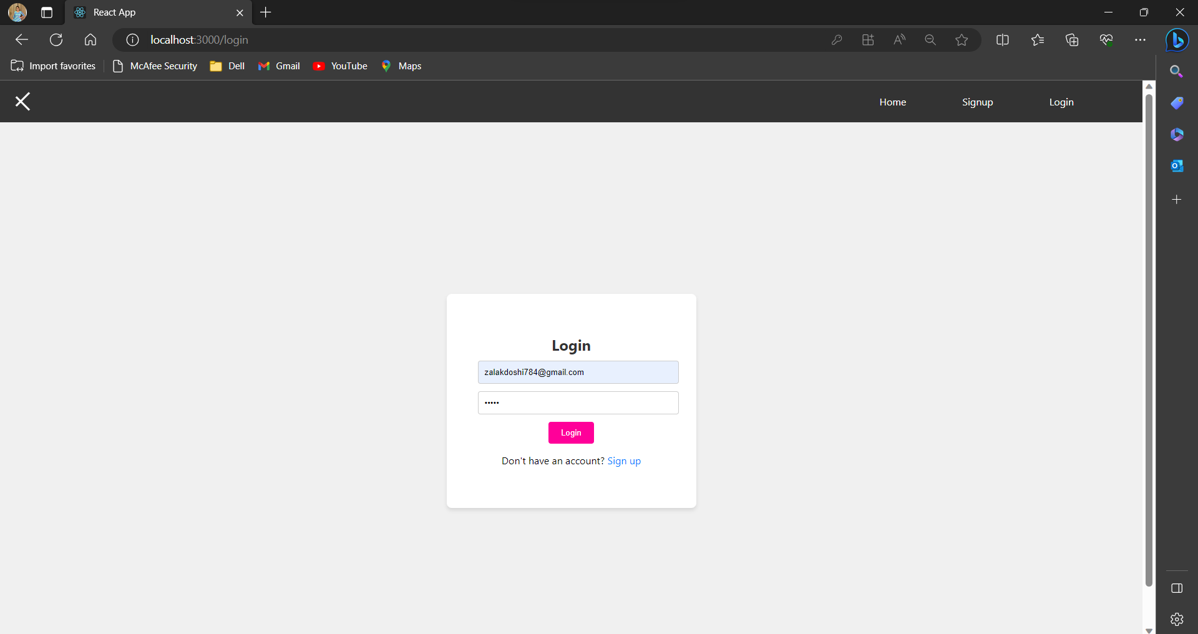
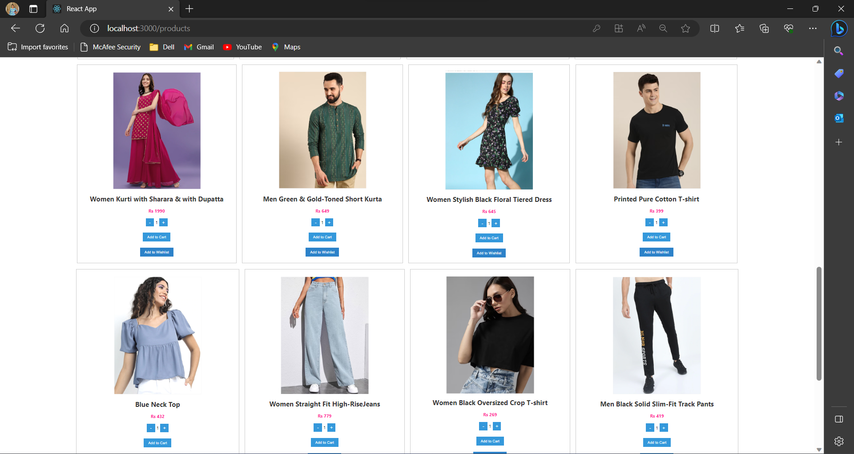
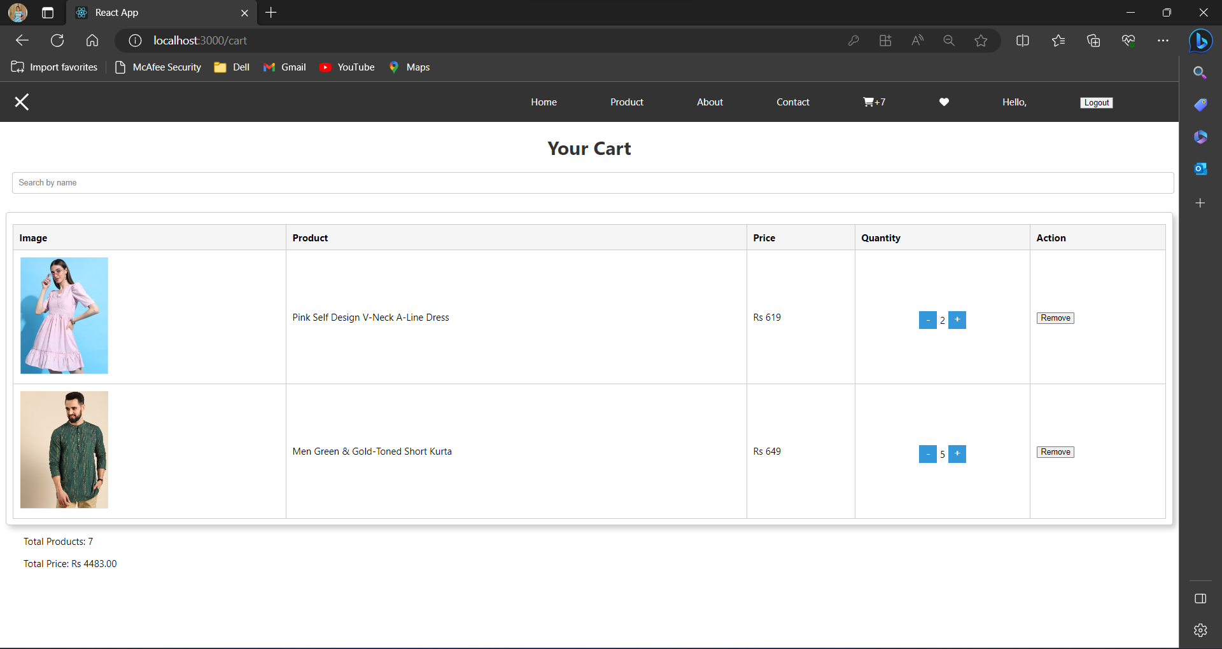
Screen shot of pages:-

Slide 11
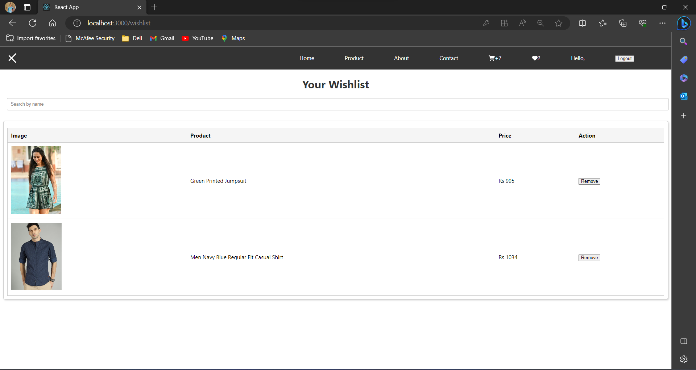
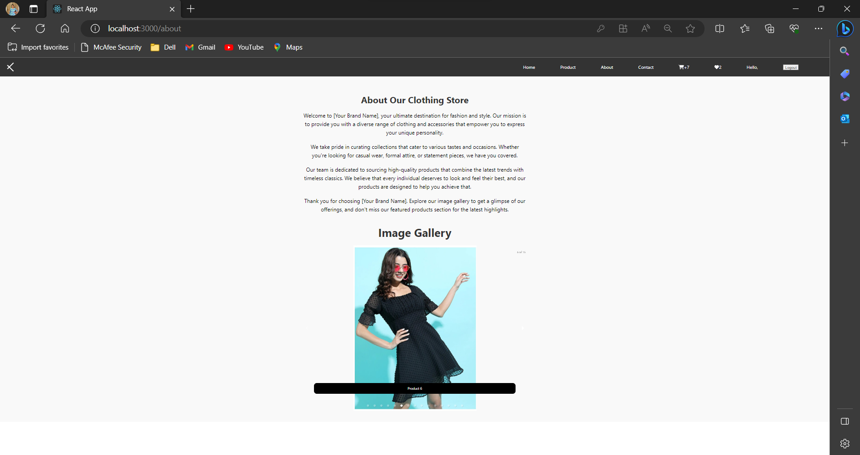
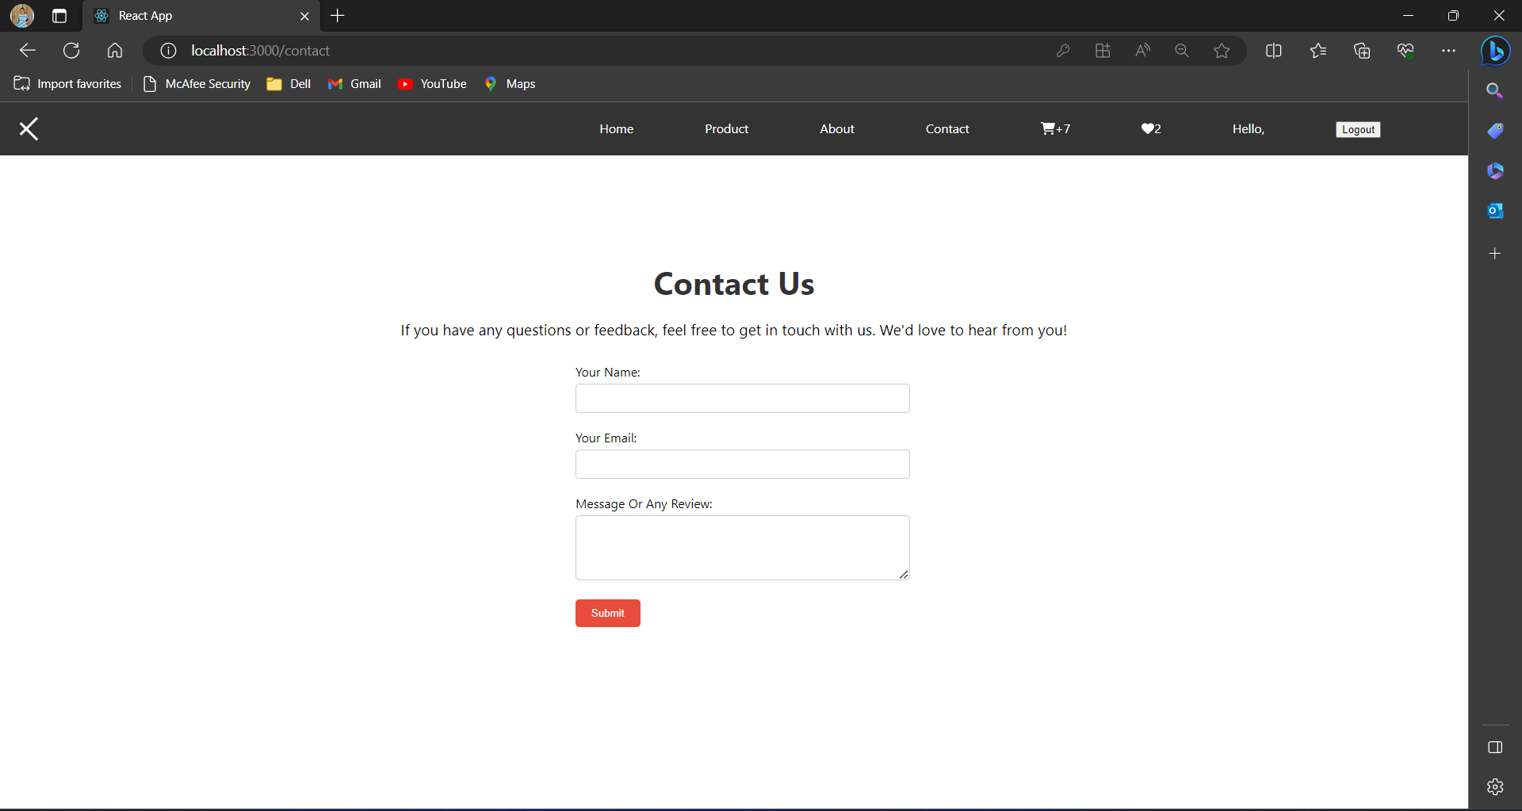

Slide 12
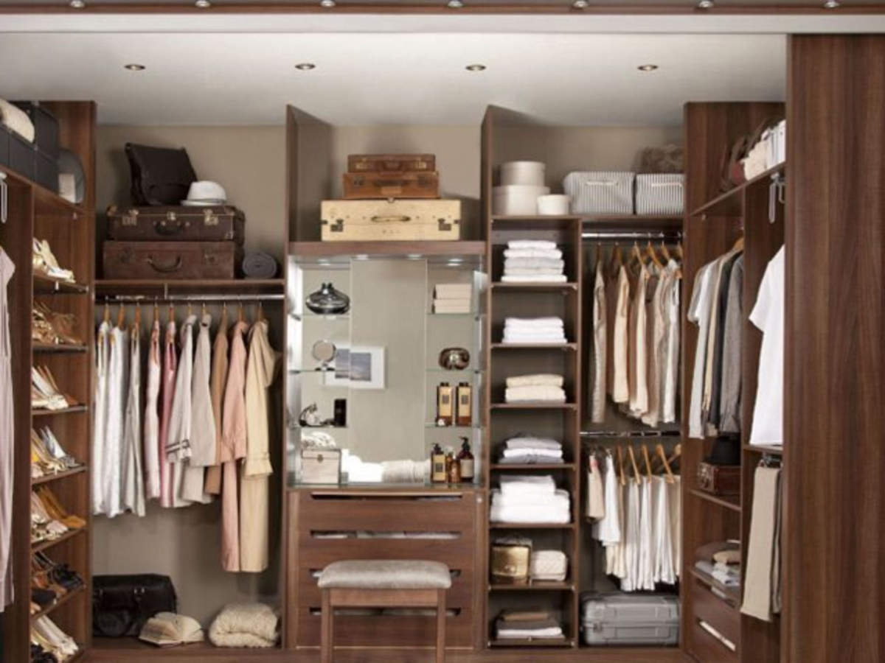
About Us
About Us:-
Welcome to our e-commerce website, your go-to destination for the latest fashion trends and wardrobe essentials. We're more than just an online clothing store; we're your fashion partner on the journey to looking and feeling your best.
Our story begins with a passion for fashion and a commitment to making style accessible to everyone. Founded by a team of fashion enthusiasts, we embarked on a mission to curate the most stylish and diverse collection of clothing for all ages, sizes, and tastes.
Our Vision:-
Our vision is simple yet ambitious: to inspire confidence through fashion. We believe that what you wear is an expression of your unique personality, and it should empower you to shine, no matter the occasion. Whether it's a casual day out, a special event, or a cozy night in, we have the perfect ensemble to suit your style.

Slide 13




Thank You
Zalak Doshi
+91 8320301019
zalakdoshi784@gmail.com

